Slide 1

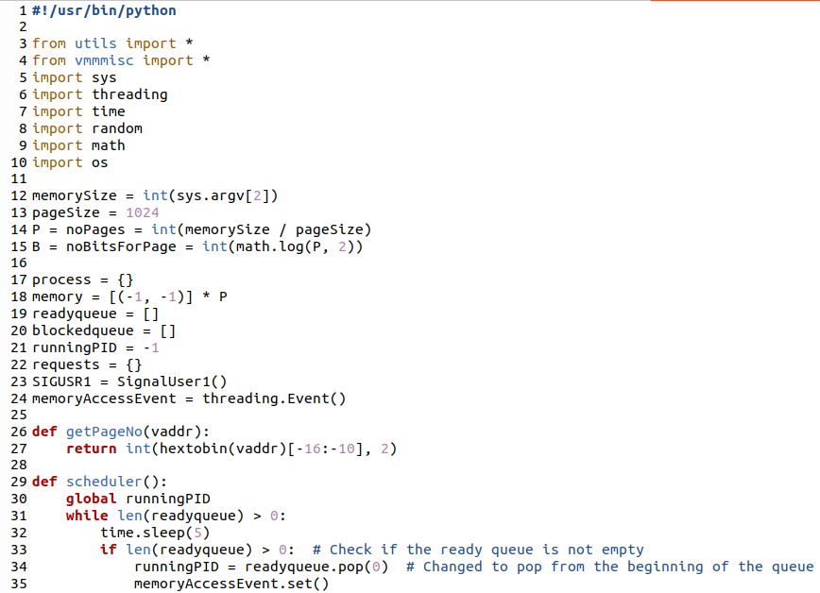
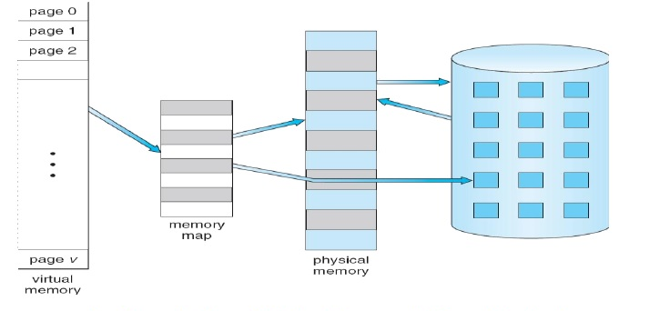
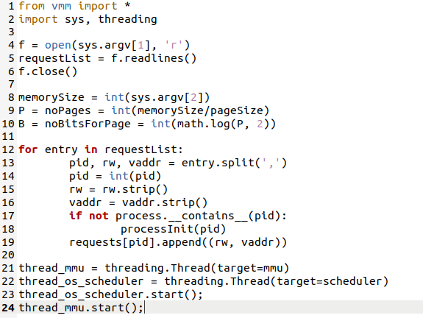
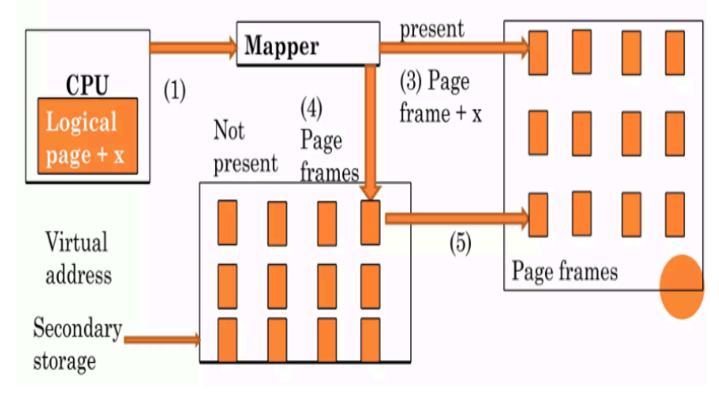
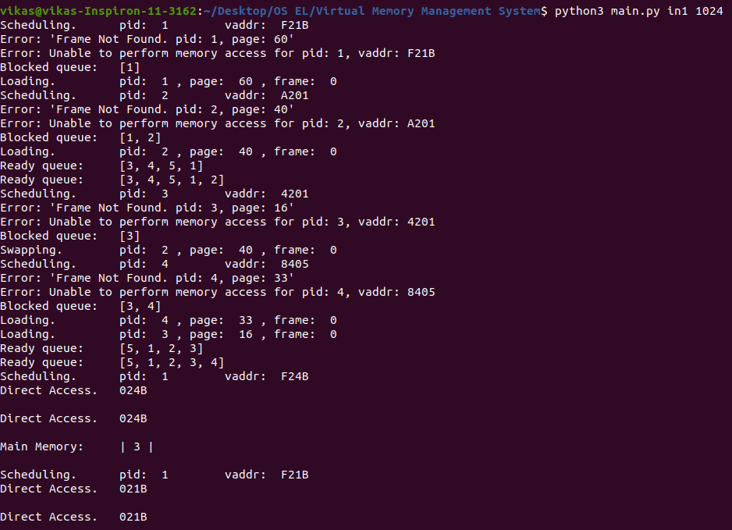
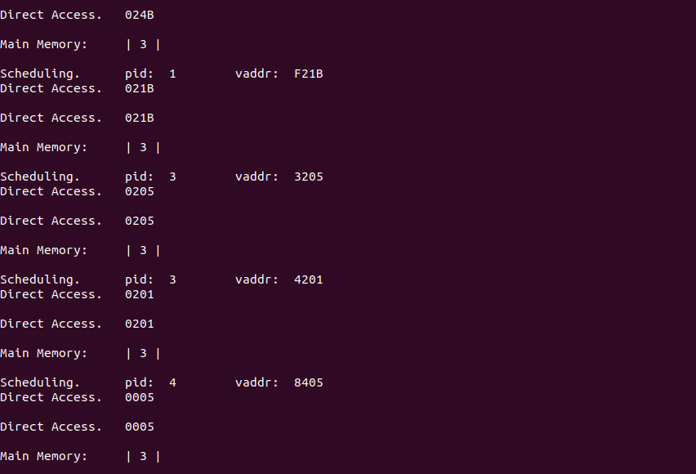
RV College of Engineering
Go, change the world
Implementing Virtual Memory
Management System
Name : Vikas J RVCE23BCS404
Wilson RVCE23BCS418
Introduction to Implementing Virtual Memory Management System :
In the realm of computer science, the concept of virtual memory stands as a cornerstone for modern operating systems (OS). Virtual memory is a powerful abstraction that allows programs to operate as if they have access to a vast and contiguous block of memory, despite the limitations of physical RAM (Random Access Memory). virtual memory management plays a pivotal role in efficiently utilizing system resources and providing a seamless user experience. Operating Systems (OS) use virtual memory to abstract physical memory resources, enabling processes to access memory locations that may not necessarily reside in the main physical memory (RAM). This abstraction is crucial for multitasking environments where numerous processes compete for limited physical memory resources.
Source code
Object Detection with Software:
No Object is Detected(Green LED)
Object is Detected(Red LED)
Problem Statement :
Design and implement an efficient virtual memory management system for an operating system to address the challenges of optimizing page replacement policies, minimizing page faults, and enhancing overall system performance. The system should be capable of dynamically managing the allocation and deallocation of virtual memory space, ensuring seamless interaction between physical and virtual memory, and implementing effective page replacement strategies.
Main.py
System Architecture :
The system architecture of a virtual memory management system in an operating system involves several components working together to provide efficient memory abstraction, allocation, and management. Here's an overview of the typical architecture:
Output - 1
Methodology :
The methodology used in virtual memory management systems involves a combination of algorithms, techniques, and data structures to efficiently manage the virtual to-physical memory mapping and handle memory operations.
Application :
VMM allows processes to access a larger address space than the physical memory available. Each process has its own virtual address space, which doesn't need to directly correspond to the physical RAM size.
Virtual memory enables memory protection by assigning different access permissions (read, write, execute) to different segments of memory. Unauthorized access attempts trigger memory protection faults, helping to enhance system security.
Virtual memory systems employ demand paging techniques to bring data into memory only when it is needed, reducing the amount of data that needs to be loaded into memory at any given time and improving overall system performance.
Guide Information:
Dr. Jyoti Shetty Assistant Professor

